Slide 1


Child-Flourish
Integrated Learning, Emotional Intelligence Platform
Project ID : 24-25J-188

Slide 2









OUR TEAM
Our Team
Ms. Malithi Nawarathne
K.R.K Vidyaratna
IT21295706
LEADER
(+94) 772256676
it21295706@my.sliit.lk
Siriwardana K.D.S.P
IT21293894
(+94) 71 088 8133
it21293894@my.sliit.lk
Prof.Pradeep Abeygunawardhana
SUPERVISOR
Ms. Malithi Nawarathne
CO – SUPERVISOR
Dr.Nilushi Weerapperuma
EXTERNAL SUPERVISOR
Prasadi P.G.K.R
IT21302626
(+94) 70 594 5095
it21302626@my.sliit.lk
Dulangi G.K.N
IT21277290
(+94) 77 0431140
it21277290@my.sliit.lk

Slide 3

Research Problem
Parents often struggle to balance work with their children's early education and development, especially for kids aged 8 to 11, a crucial period for social, emotional, and cognitive growth.

Slide 4
Background
There’s a need for improved methods to identify and support children with Autism Spectrum Disorder (ASD) and ADHD.
There is a growing recognition of the need for innovative educational tools that enhance cognitive development.
Sri Lankan parents would benefit from flexible, adaptive educational solutions that address both developmental and educational needs.

Slide 5
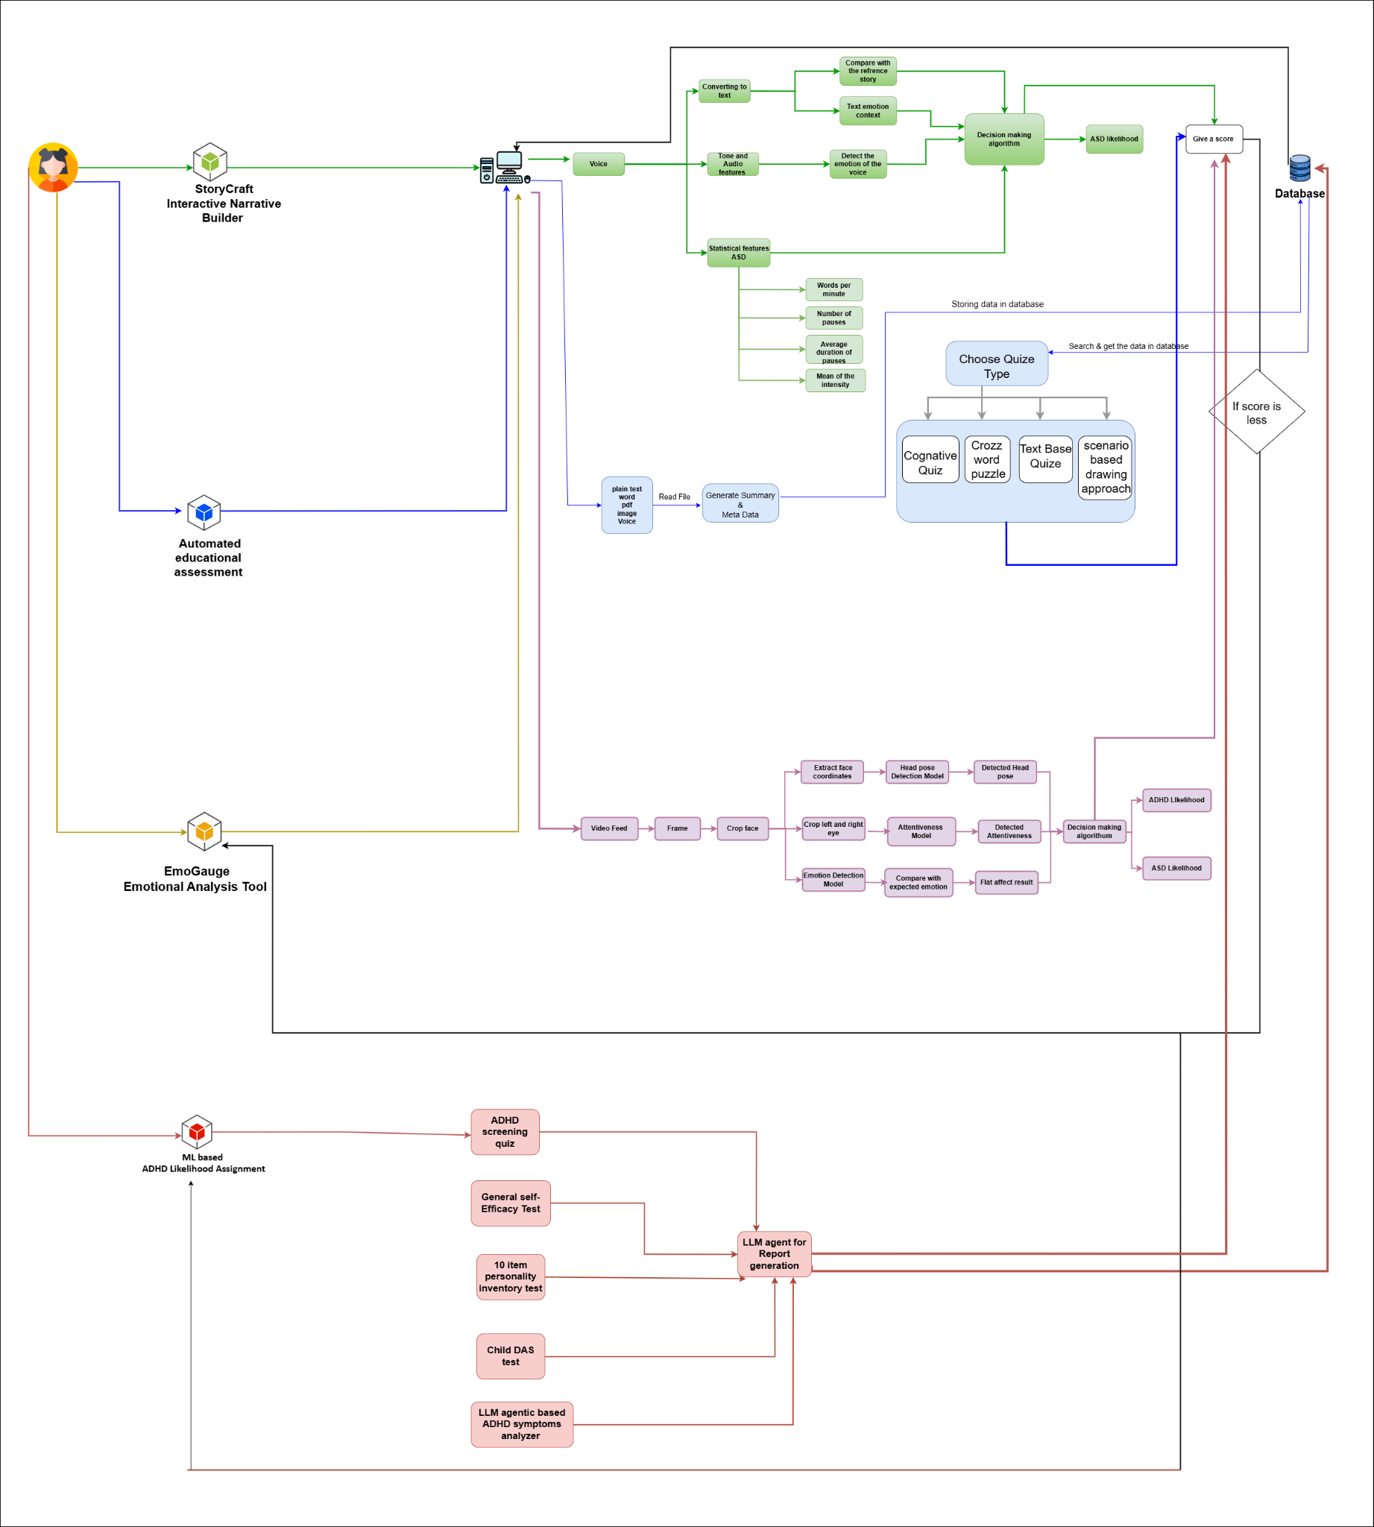
System Overview

Slide 6
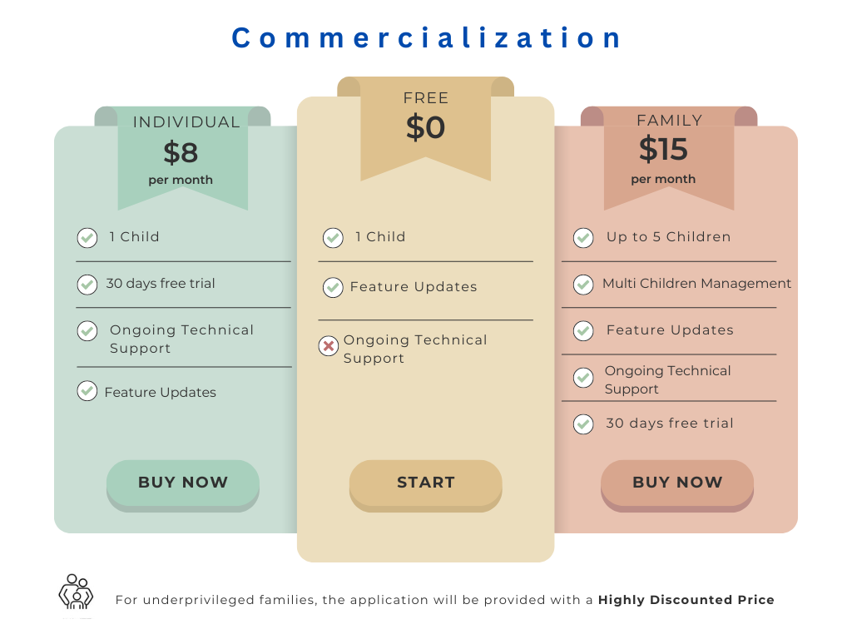

Slide 7
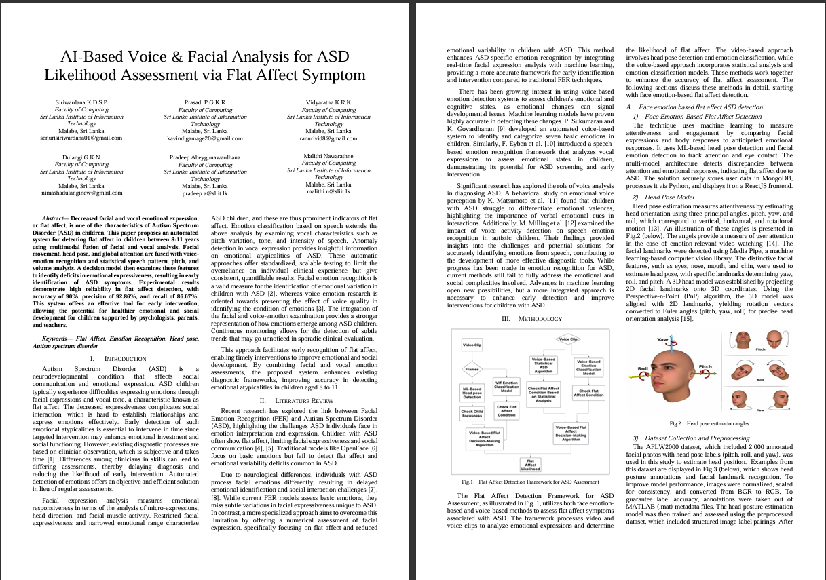

Research Paper
Research Paper
Conference submission expected
IT21302626 | Prasadi P.G.K.R | 24-25J-188

Slide 8

Individual Components

Slide 9
Component 1
ML based ADHD Likelihood Assignment
IT21295706
K.R.K Vidyaratna
Information Technology

Slide 10

Introduction
Helps early identification of ADHD in children
Goal is to utilize machine learning to predict the likelihood of ADHD based on behavioral data.
Designed to evaluate factors linked to ADHD risk in children through a comprehensive series of questionnaires.
IT21295706 | Vidyaratna K.R.K | 24-25J-188

Slide 11
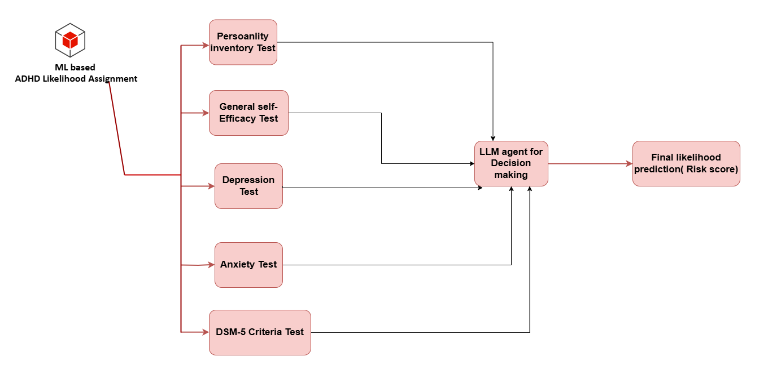
System Diagram
IT21295706 | Vidyaratna K.R.K | 24-25J-188

Slide 12



Progress PP1 to PP2
PP1 Completed PP2 Completed
All 5 questionnaires with particular test ADHD likelihood predictions
LLM agent for final risk score prediction
Frontend Development
Backend Development
Integration
ML-based self-efficasy test model
DAS Prediction(Depression, Stress, Anxitey) test model
DSM-5 criteria test model
IT21295706 | Vidyaratna K.R.K | 24-25J-188

Slide 13
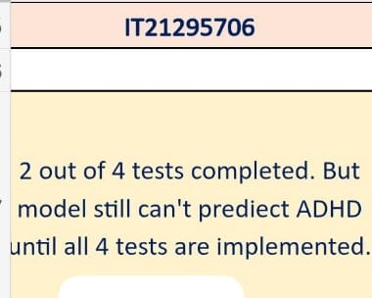
Panel Comment
Now all my tests are fully completed with the final Likilihood prediction.
IT21277290 | Dulangi G.K.N | 24-25J-188

Slide 14
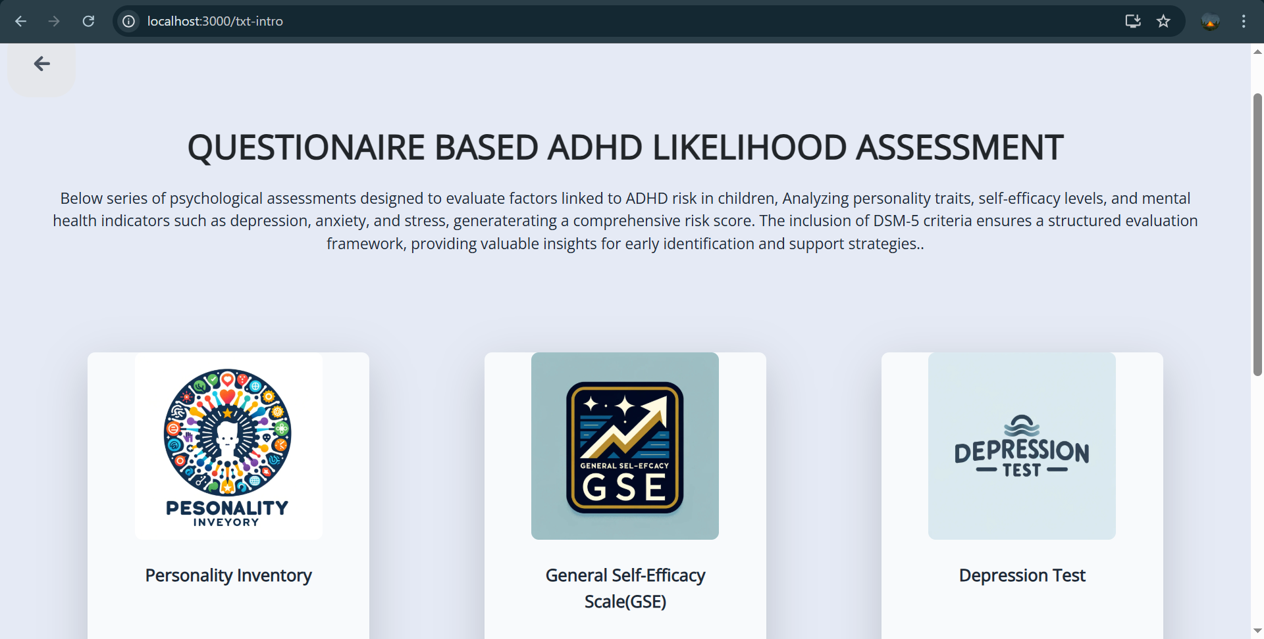
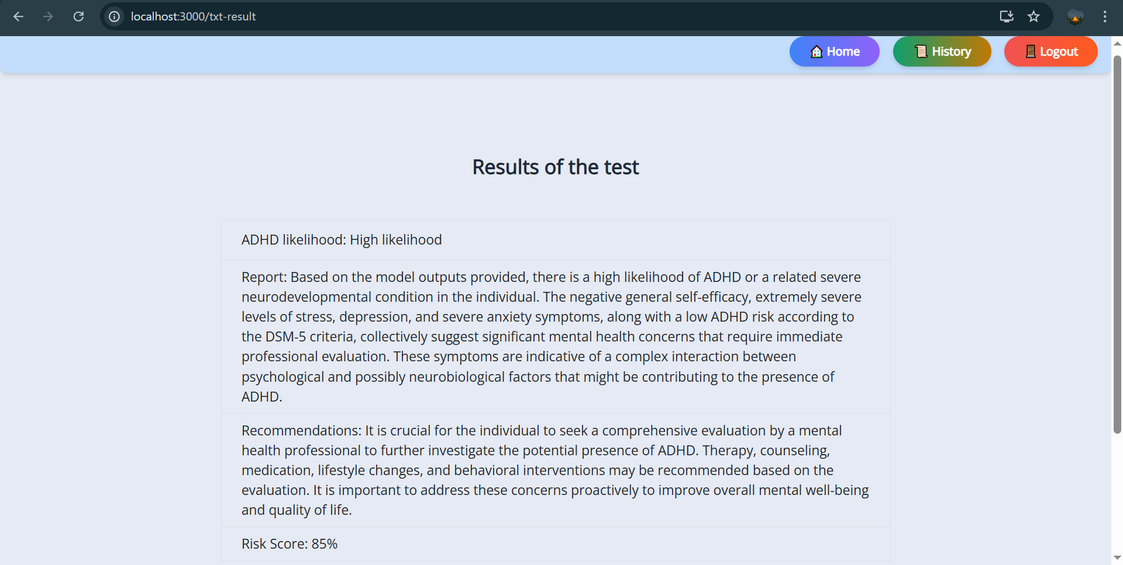
Proof of Concept
ADHD Likelihood Assessment Questionnaires
ADHD Final Risk Score Prediction
IT21295706 | Vidyaratna K.R.K | 24-25J-188

Slide 15
Component 2
Emotional Analysis Tool (EmoGauge)
IT21293894
Siriwardana K.D.S.P
Information Technology

Slide 16
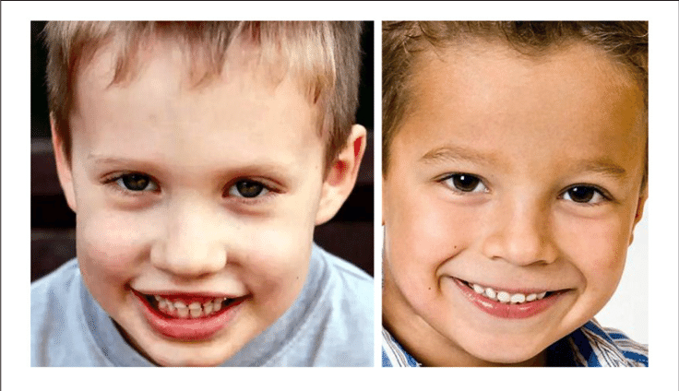

Introduction
Provide an indication of the likelihood of Autism Spectrum Disorder (ASD) by measuring flat affect in children aged 8 to 11.
Flat affect is a symptom where a person doesn't express emotions in the same way as others.
By using an emotion detection approach, facial expressions are analyzed to identify flat affect.
IT21293894 | Siriwardana K.D.S.P | 24-25J-188

Slide 17
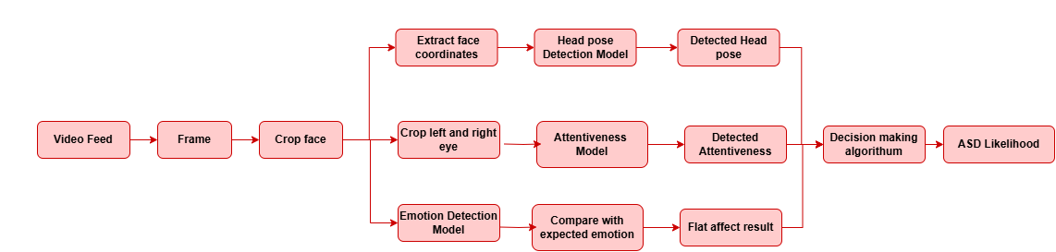
System Diagram
IT21293894 | Siriwardana K.D.S.P | 24-25J-188

Slide 18
Progress PP1 to PP2
PP1 Completed PP2 Completed
Facial Emotion Model Development
Development of Flat Affect Detection Approach
Frontend Development
Backend Development
Integration
Head Pose Detection Model
Attentiveness Detection Model
In-Progress Task
Emotion Detection Model
IT21293894 | Siriwardana K.D.S.P | 24-25J-188

Slide 19
Key Challenges
High Processing Time – Real-time emotion analysis requires significant computational power, leading to delays.
Lighting & Environmental Factors – Poor lighting or background distractions affect detection reliability.
IT21293894 | Siriwardana K.D.S.P | 24-25J-188

Slide 20
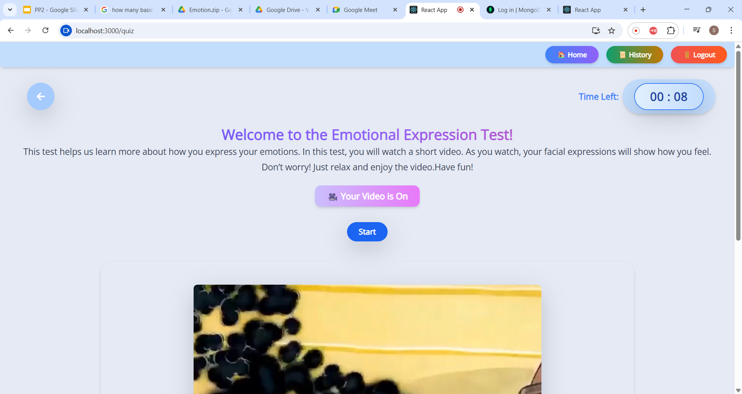
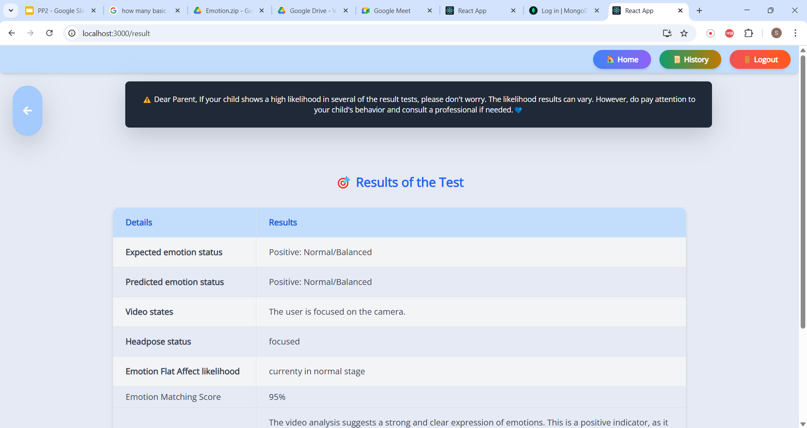
Proof of Concept
Capturing the user's emotions in real time using a webcam
Result of the test
IT21293894 | Siriwardana K.D.S.P | 24-25J-188

Slide 21
Component 3
Voice Emotion-Based ASD Flat Affect Likelihood Recognition
(StoryCraft)
IT21302626
Prasadi P.G.K.R
Information Technology

Slide 22
Introduction
Analyzes speech features and emotional context to evaluate children's emotional responses, and flat affect, which is commonly observed in individuals with Autism Spectrum Disorder (ASD).
Designed for children aged 8 to 11, it supports their educational development by improving grammar and emotional expressiveness.
IT21302626 | Prasadi P.G.K.R | 24-25J-188

Slide 23
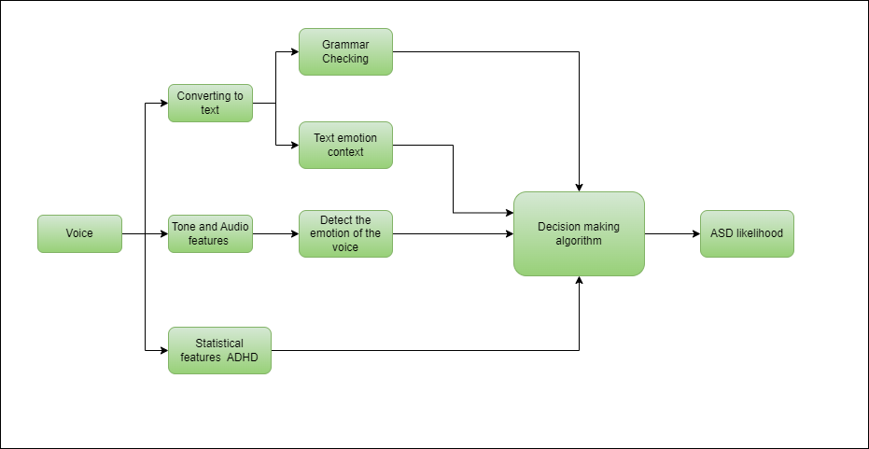
System Diagram
IT21302626 | Prasadi P.G.K.R | 24-25J-188

Slide 24
Progress PP1 to PP2
PP1 Completed PP2 Completed
Voice to Text Conversion
Text Content Emotional Detection
Decision-Making Algorithm
Text based grammar checking
Voice Emotion Classification (6 - class Classification and 3 - class Classification)
Statistical Approach for ASD detection
IT21302626 | Prasadi P.G.K.R | 24-25J-188

Slide 25
Key Challenges
Limited Voice Input Duration – The system can only capture and analyze up to 10 seconds of speech due to the need for efficient processing and real-time feedback.
Speech Variability and Noise – Background noise, unclear pronunciation, and individual differences in speech patterns can impact the accuracy of vocal emotion detection.
IT21302626 | Prasadi P.G.K.R | 24-25J-188

Slide 26
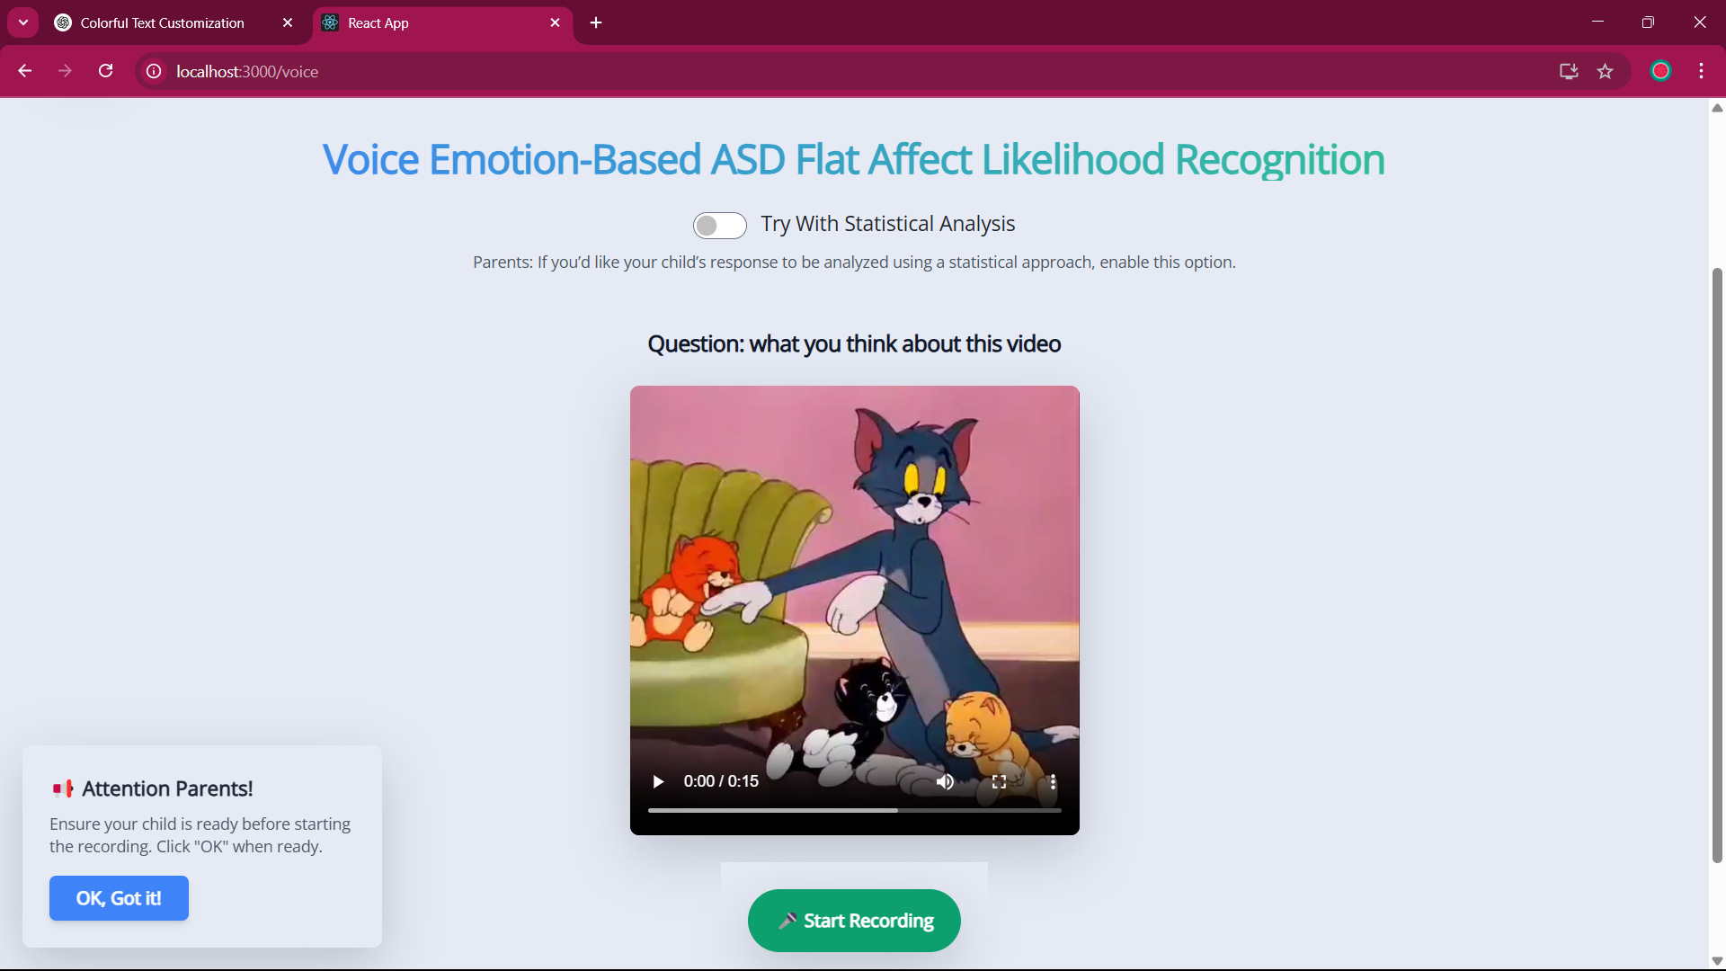
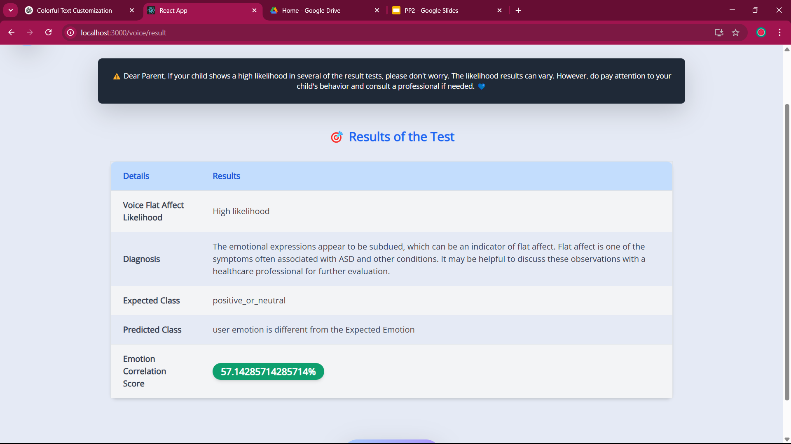
Proof of Concept
Recording the child’s voice emotions in real time
Result of the test
IT21302626 | Prasadi P.G.K.R | 24-25J-188

Slide 27
Component 4
Automated Educational Assessment System for Cognitive Development
IT21277290
Dulangi G.K.N
Information Technology

Slide 28
Introduction
This is focusing on enhancing children’s learning through personalized assessments while also identifying potential cognitive and emotional challenges like ADHD , ADD likelihood
IT21277290 | Dulangi G.K.N | 24-25J-188

Slide 29
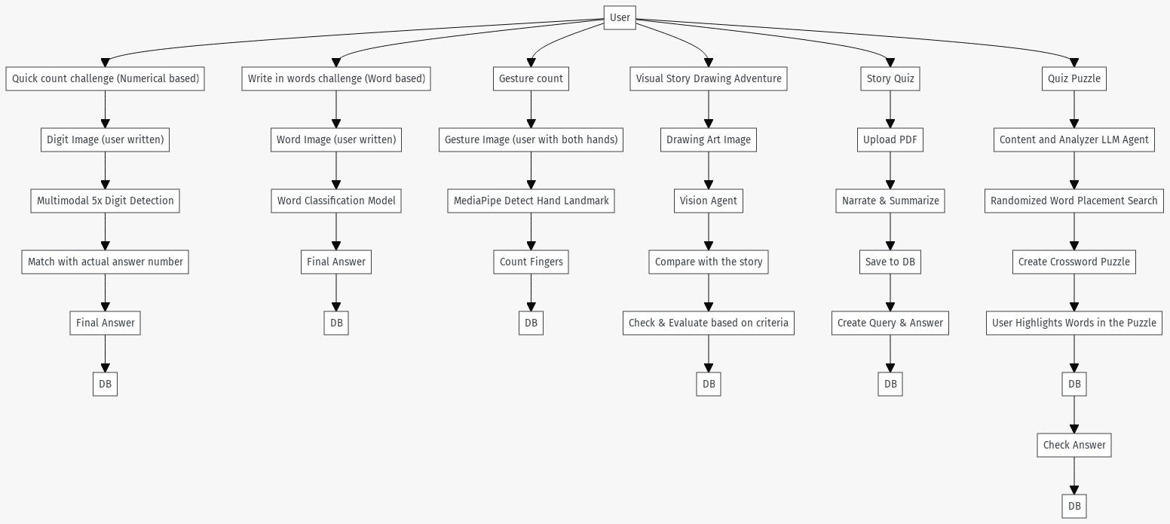
System Diagram
IT21277290 | Dulangi G.K.N | 24-25J-188

Slide 30

Progress and Deliverables
PP1 PP2
Quick count challenge
Write in word challenge
Gesture count challenge
Visual story drawing challenge
MCQ-type quiz generation
Cognitive quiz approach
Quiz puzzle
Automated crossword puzzle generation
Scenario-based drawing approach
IT21277290 | Dulangi G.K.N | 24-25J-188

Slide 31
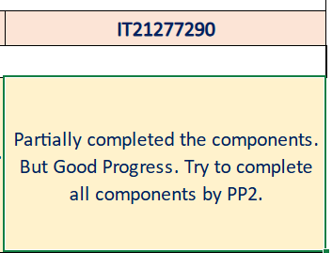
Panel Comment
I complete my all component.
IT21277290 | Dulangi G.K.N | 24-25J-188

Slide 32
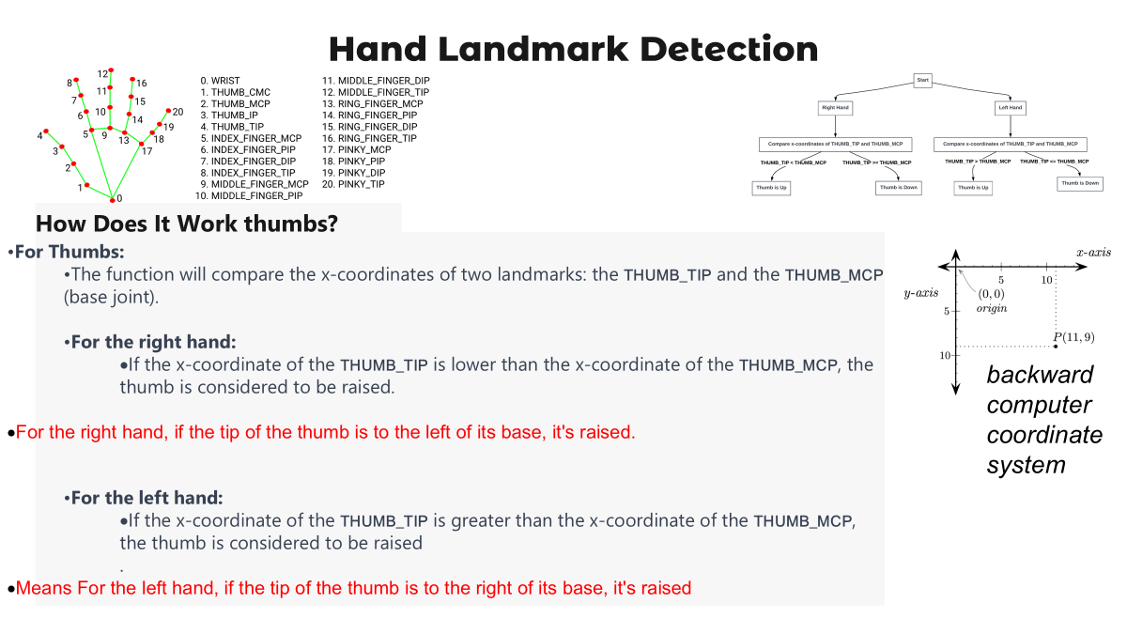
IT21277290 | Dulangi G.K.N | 24-25J-188

Slide 33
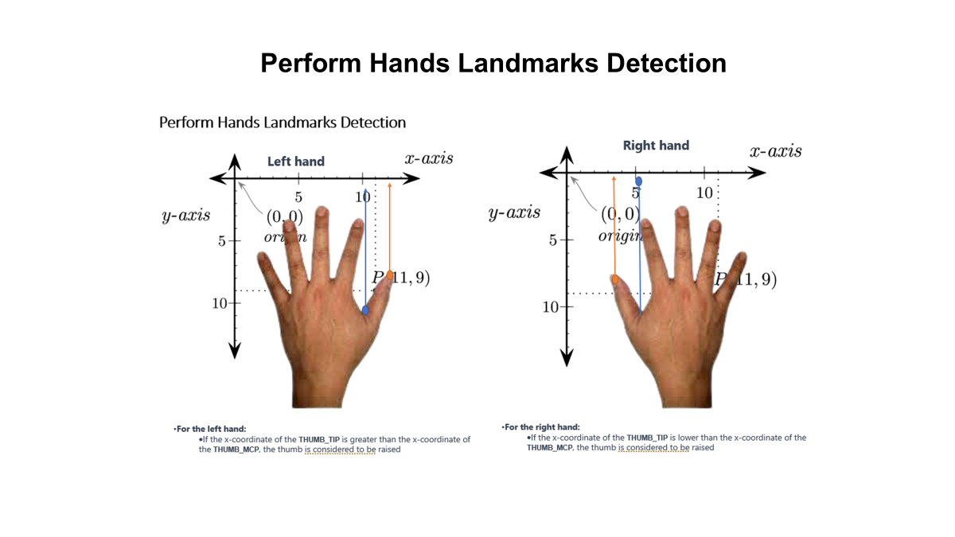
IT21277290 | Dulangi G.K.N | 24-25J-188

Slide 34

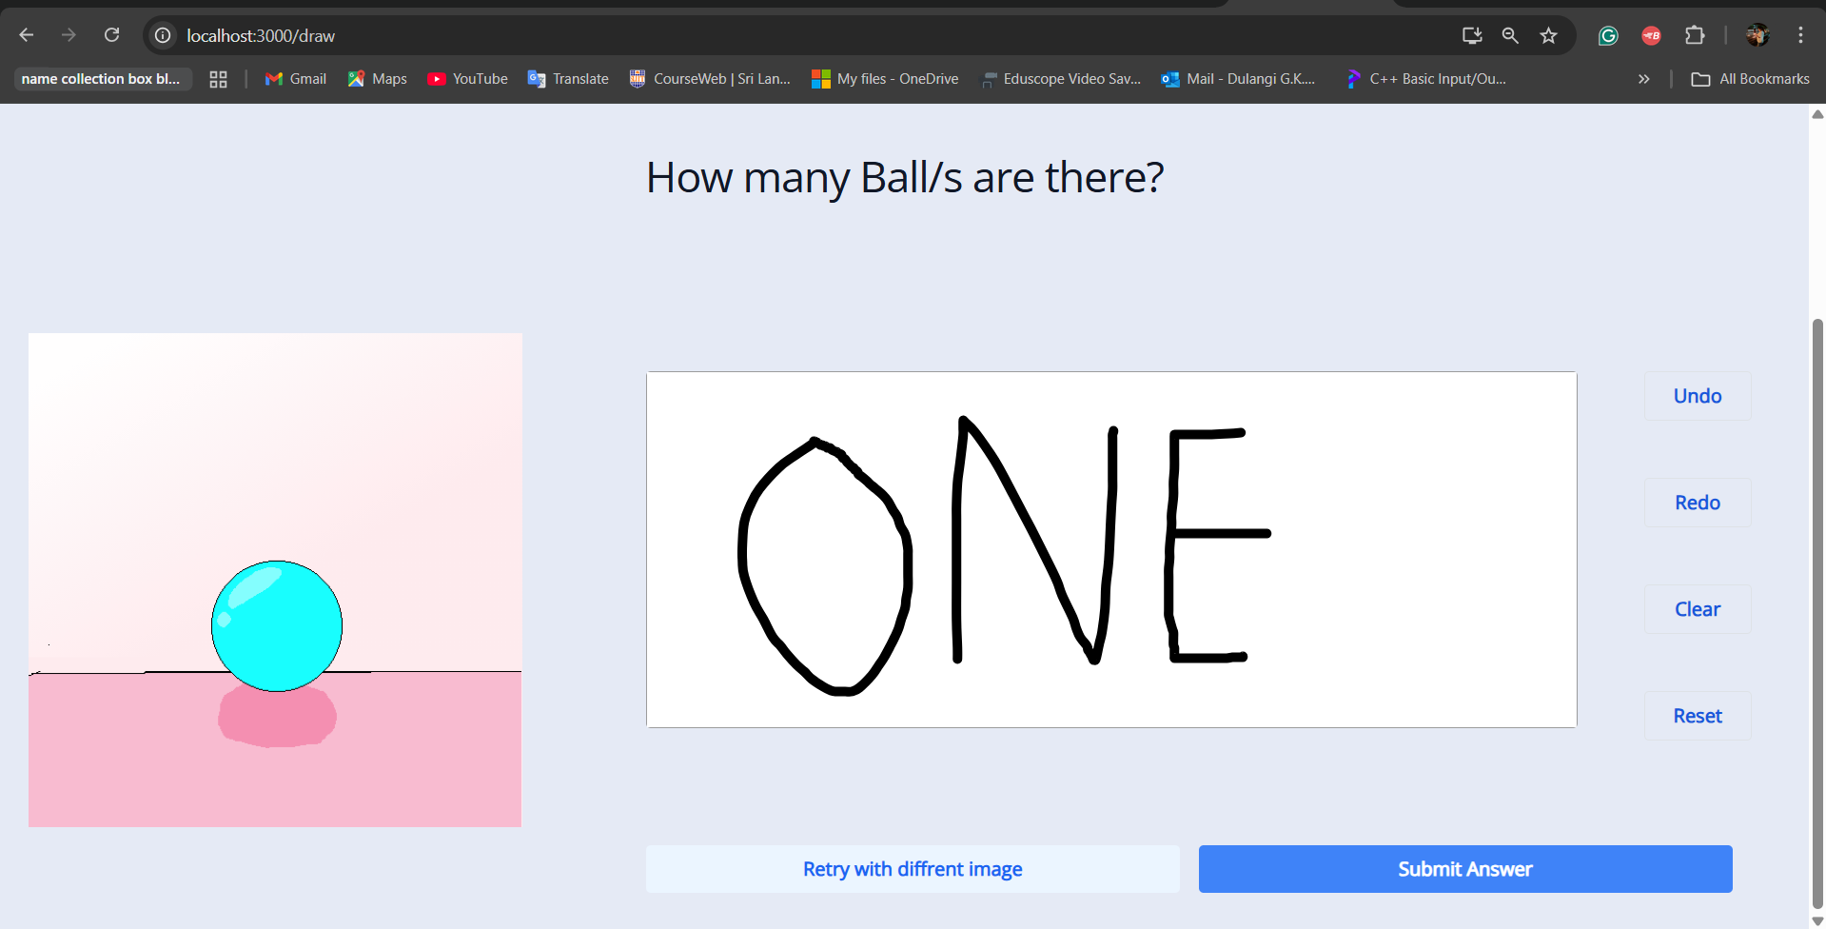
Proof of Concept
Digit Prediction
Digit Prediction
IT21277290 | Dulangi G.K.N | 24-25J-188

Slide 35
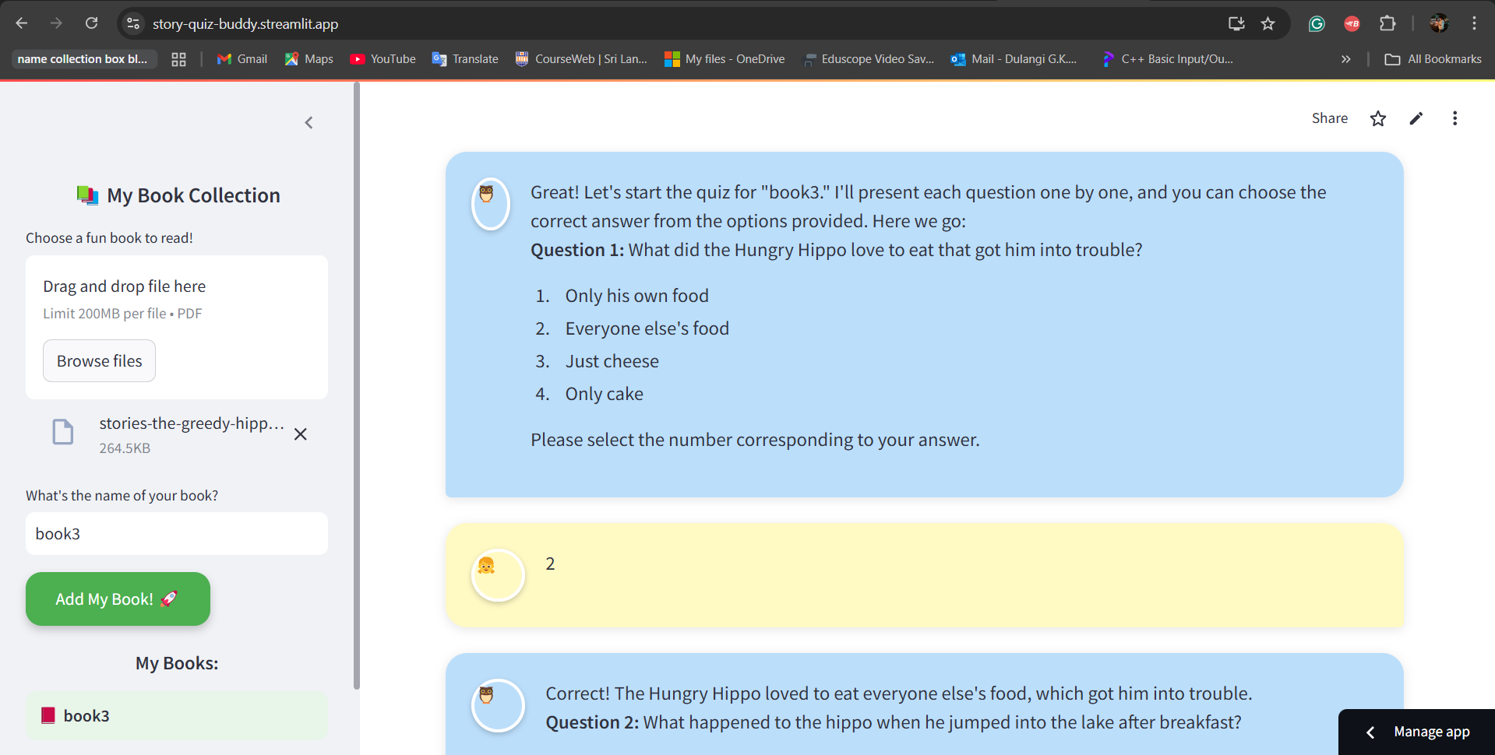
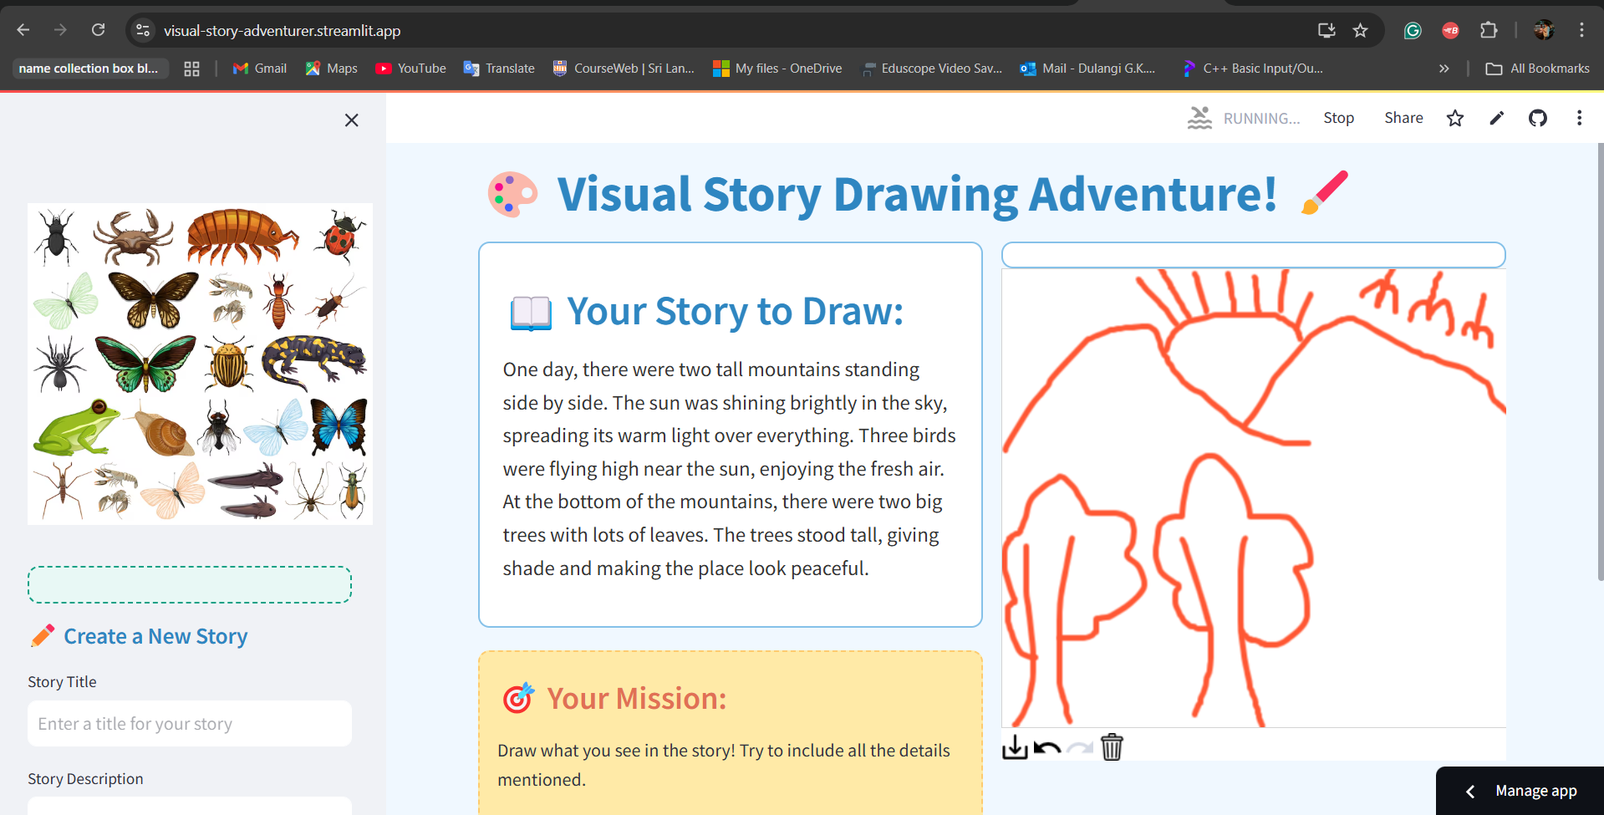
Proof of Concept
Quiz Buddy
Story Drawing
IT21277290 | Dulangi G.K.N | 24-25J-188

Slide 36


THANK YOU!

